Slide 1
Azure Blockchain

Slide 2
Abstract and learning objectives
In this Whiteboard design session, you will work with a group to learn how to build and configure an Internet of Things (IoT) Audit Solution using Azure Blockchain. You will do this using Ethereum Blockchain with the use of Smart Contracts to collect device telemetry information in addition to enforce contract specifics related to conditions during transport of goods. Specifically, the IoT devices will report temperature and humidity data that will be validated through the Smart Contracts against agreed upon acceptable ranges.
At the end of this session, you will be able to deploy and configure Azure Blockchain Workbench, write and deploy Ethereum Smart Contracts with Solidity, and integrate both IoT and Blockchain together into a single solution.

Slide 3
Step 1: Review the customer case study
Outcome
Analyze your customer needs.
Timeframe
15 minutes

Slide 4
Customer situation
Northwind Traders is the world’s largest food and beverage company. The company has a long history of innovation since its founding more than 150 years ago. Over the last few years, Northwind has been increasing their emphasis on tracking their products from the origin of the raw materials all way through the manufacturing process to the consumer. They pride themselves on being able to certify both the origin and delivery of their products with high accuracy.
With multiple shipping companies and methods, from trucks, to trains, to ships, it is very difficult to guarantee traceability and accuracy of the shipping data. It is also very difficult to avoid inefficiencies and profit losses. The CEO of Northwind Traders, John Adams, states, “The solution to guaranteeing the quality of our products health is guaranteeing our products health, is complete control of the supply chain.”

Slide 5
Customer situation
Coordinating the traceability and accuracy of shipping information across the supply chain is a complex task that requires cooperation and coordination between many different companies and government organizations. Northwind Traders has spent a lot of resources and money to guarantee the accuracy of this data over the years, as well as the security and privacy of the data. Over the years this has required the coordination across languages, and political boundaries, in addition to the efforts of the many different companies involved.
Jill Anders, the CTO of Northwind Traders has reached out to you to help them build a truly innovative solution to better track their shipments. Jill says, “We need a system that is more secure, more efficient, and will help us lower not just IT costs, but other costs across the organization.” They’ve heard of Blockchain and Smart Contract technologies and are thinking these may help them solve this problem.

Slide 6
Customer situation
As the most innovative company in their industry, they do implement Internet of Things (IoT) devices to track product storage and shipment. They do this mostly using Temperature and Humidity sensors mounted within warehouses and shipping containers. While this is something that’s easy to implement on Northwind Traders properties, it can be difficult to implement across all shipping partners, distributors, and other entities involved. They are looking to additionally integrate these IoT Sensors into their entire supply chain tracking to better increase the level of transparency and traceability of shipping data.
The Northwind Traders engineering team is currently working on adding additional sensor support to the IoT tracking devices they are planning to deploy in the near future. With tracking shipments, a key feature they are working on is the addition of GPS (Global Positioning System) sensors to better enable them to track package locations in real-time. They are also looking to augment some of their IoT devices with Cellular-based Internet connectivity, in addition to Wi-Fi.

Slide 7
Customer situation
Regarding better transparency and traceability of their products, as well as origin materials, the CEO of Northwind Traders, says “I wish we could better track the environment information while our shipments are in the hands of Customs and other Government organizations. It would also help to have a better view into our resellers too.” The overall tracking of shipments is a major concern for the company. They want to better track shipments, not just for insurance and quality control reasons, but also so they can better guarantee where supplies are and who’s handling them as they flow through the system from raw material to final product sold to consumers.

Slide 8
Customer needs
A more seamless system is needed to manage the supply chain, all the way from farmer to consumer.
Easy audit transparency is an important feature, as Northwind Traders needs to coordinate with Customs and other political organizations with ease.
The system needs to have immutability of data built as a core feature, to prevent fraud, intentional or otherwise, by partners and third-parties. This will ease audits for regulatory and insurance needs.
The Blockchain implementation needs to be secure and fully under the control of Northwind Traders; while simultaneously integrating with partners and third-parties when managing the supply chain.
Both new and existing IoT device sensors need to be integrated to ensure the highest quality shipping conditions are maintained; in addition to tracking locations as necessary.

Slide 9
Customer objections
There's a lot of popular interest in Blockchain, and we only understand enough to know it could be useful. We heard it’s extremely expensive to implement and/or built a POC (Proof of Concept) solution. Is this true?
We’ve heard Azure Blockchain Workbench uses the Ethereum cryptocurrency. This really doesn’t seem like the secure solution we need if our data will be out on the public Ethereum Blockchain that anyone can access.
When adopting Blockchain and Smart Contract technologies, what does the learning curve look like for your development team?

Slide 10
Customer objections
How are user accounts or Blockchain wallets managed within Azure Blockchain Workbench? We really need to make sure we have complete control over the security of the entire system.
We will have a mixture of IoT devices connecting to the network over either Wi-Fi or Cellular connections. Will it be an issue to integrate these devices and their sensor data with Azure Blockchain Workbench?
Is Azure AD really needed? We already have another directory service solution in place. We can’t change it simply because we want to leverage Blockchain!

Slide 11
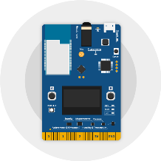
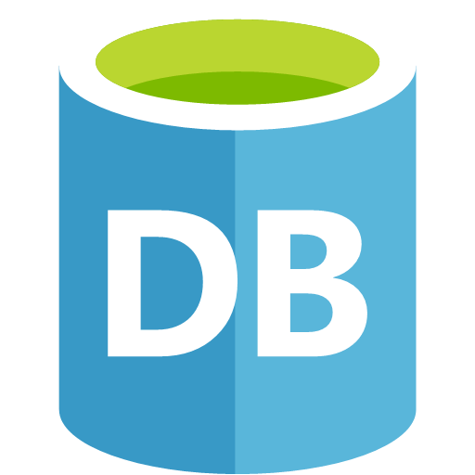
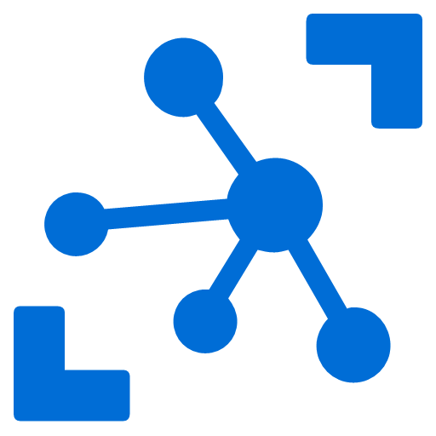
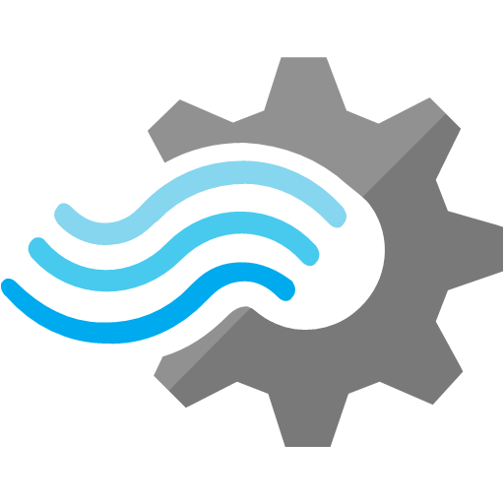
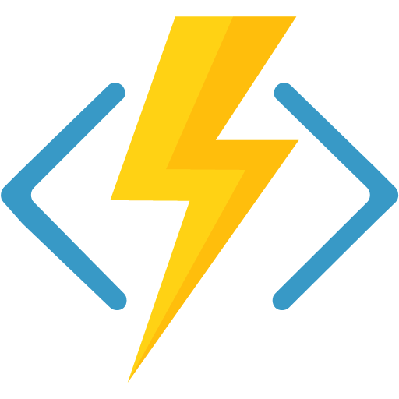
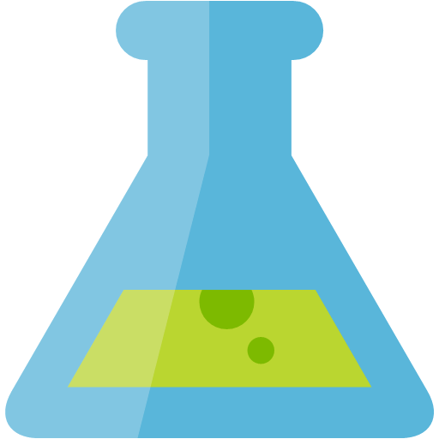
Common scenarios IoT / Big Data Lambda Architecture
Batch Processing
Azure IoT Hub
Stream Analytics
IoT Devices
Real-Time Processing and Analytics
Notes:
The Lambda Architecture design pattern, as used in both Internet of Things and Big Data solutions, enables these solutions to handle massive quantities of data by taking advantage of both Batch processing and Real-Time Stream processing methods within the same solution.
LINKS:
https://en.wikipedia.org/wiki/Lambda_architecture
Azure IoT DevKit image from https://microsoft.github.io/azure-iot-developer-kit/

Slide 12
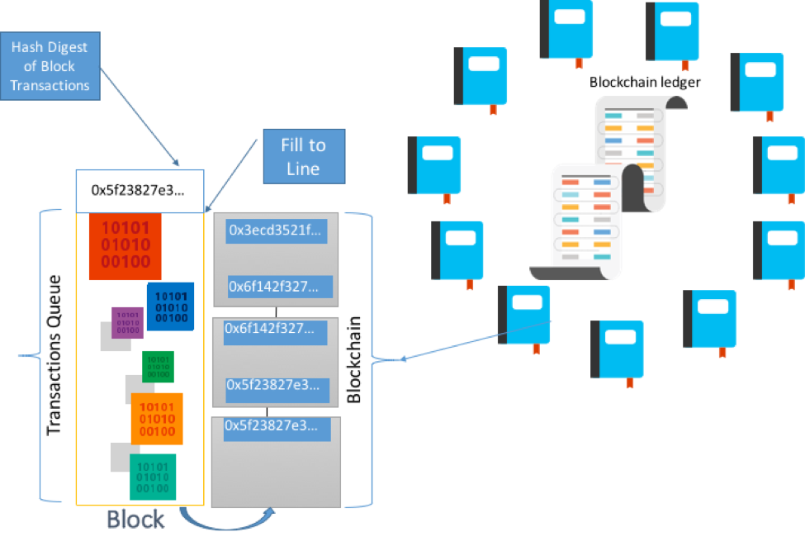
Common scenarios Blockchain Ledger
Notes:
This is an example of a Blockchain Ledger. When enough transactions in the ledger fill up an entire block, then that block is committed to the Blockchain Ledger in a secure, immutable way that utilizes hashing to ensure security. The block is then distributed across the blockchain network, and each node in the network validates the block.
LINKS:
https://github.com/Azure/azure-blockchain-projects/blob/master/bletchley/bletchley-whitepaper.md

Slide 13
Step 2: Design the solution
Outcome
Design a solution and prepare to present the solution to the target customer audience in a 15-minute chalk-talk format.
Timeframe
60 minutes
Business needs (10 minutes) | Respond to questions outlined in your guide and list the answers on a flipchart.
Design (35 minutes) | Design a solution for as many of the stated requirements as time allows. Show the solution on a flipchart.
Prepare (15 minutes) | Identify any customer needs that are not addressed with the proposed solution. Identify the benefits of your solution. Determine how you will respond to the customer’s objections. Prepare for a 15-minute presentation to the customer.

Slide 14
Step 3: Present the solution
Outcome
Present a solution to the target customer in a 15-minute chalk-talk format.
Timeframe
30 minutes (15 minutes for each team to present and receive feedback)
Directions
Pair with another table.
One table is the Microsoft team and the other table is the customer.
The Microsoft team presents their proposed solution to the customer.
The customer asks one of the objections from the list of objections in the case study.
The Microsoft team responds to the objection.
The customer team gives feedback to the Microsoft team.

Slide 15
Wrap-up
Outcome
Identify the preferred solution for the case study.
Identify solutions designed by other teams.
Timeframe
15 minutes

Slide 16
Preferred target audience
John Adams, CEO
Jill Anders, CTO

Slide 17
Preferred solution
Blockchain + IoT Solution
Azure Blockchain Workbench
Ethereum Blockchain with Smart Contracts
Azure IoT Suite services
Azure IoT Hub integrated with Lambda Architecture and IoT Devices

Slide 18
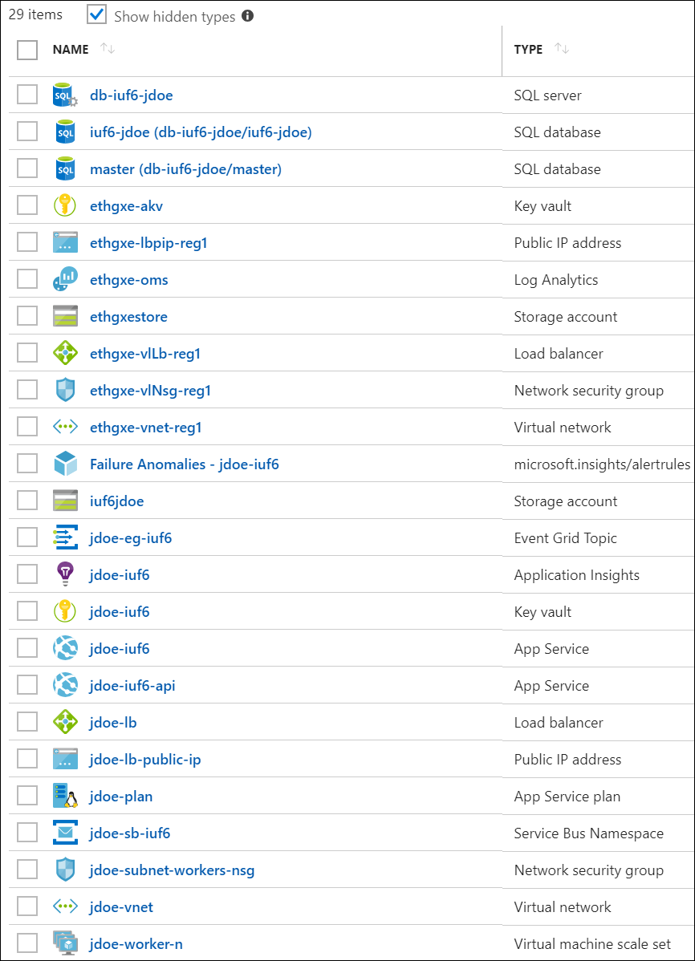
Preferred solution
Azure Blockchain Workbench
Quicker, Easier to POC Blockchain solutions.
Many Azure services stitched together for you.
Uses:
Ethereum Blockchain
Smart Contracts written in Solidity language

Slide 19
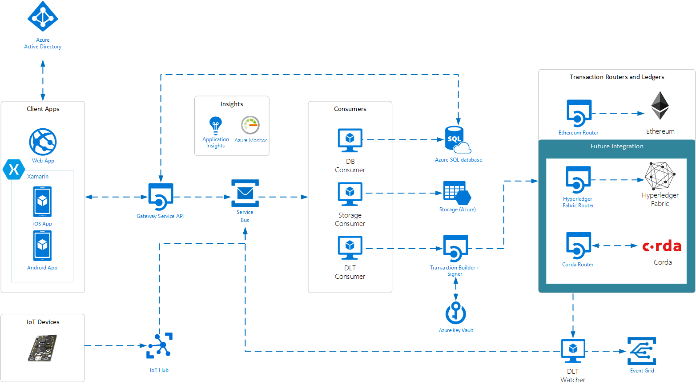
Preferred solution – Blockchain Workbench
Notes:
Azure Blockchain Workbench simplifies blockchain application development by providing a solution using several Azure components. Blockchain Workbench can be deployed using a solution template in the Azure Marketplace. The template allows users to pick the modules and components to deploy with Blockchain Workbench, such as blockchain stack, type of client application, and support for IoT integration. Once deployed, Blockchain Workbench provides access to a web app, iOS app, and Android app.
Reference Link:
https://docs.microsoft.com/en-us/azure/blockchain-workbench/blockchain-workbench-architecture

Slide 20
Preferred solution
IoT device and sensor integration
Using Azure IoT Suite services
Azure IoT Hub, Stream Analytics, Service Bus Queue, Logic Apps
Enable Lambda Architecture to be integrated
Full 2-Way Communication and Device Management Capabilities
Required sensors: Temperature, Humidity
Additional supported sensors: GPS, Barometric Pressure, and others

Slide 21
Preferred solution
Azure Blockchain Workbench Extensibility
Uses an Azure Service Bus Queue to provide extensibility point
IoT part of solution can send telemetry to Azure Blockchain Workbench’s Service Bus Queue to send sensor data to Blockchain Smart Contract to be validated for compliance

Slide 22

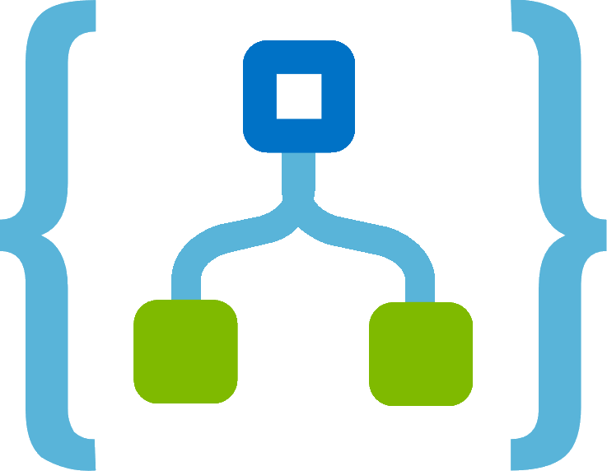
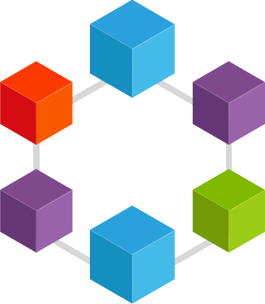
Preferred solution – IoT Device Integration
Azure IoT Hub
Stream Analytics
Service Bus Queue
Logic Apps
Azure Blockchain Workbench
(using Ethereum)
IoT Devices
Notes:
A device communicates directly or via a field gateway to IoT Hub.
Azure Stream Analytics receives the device messages from IoT Hub, and evaluates the messages.
Azure Stream Analytics then sends the messages to Azure Service Bus.
A Logic App or other custom code retrieves and transforms the message to a known format.
The transformed message, now in a standard format, is sent to the Azure Service Bus for Azure Blockchain Workbench.
Azure Blockchain Workbench is subscribed to events from the Service Bus, and retrieves the message.
Azure Blockchain Workbench initiates a call to the ledger, sending data from the external system to a specific contract.
Upon receipt of the message, the contract evaluates the data and may change the state based on the outcome of the evaluation, for example, for a high temperature, change the state to ‘Out of Compliance’.

Slide 23
Preferred objections handling
There's a lot of popular interest in Blockchain, and we only understand enough to know it could be useful. We heard it’s extremely expensive to implement and/or built a POC (Proof of Concept) solution. Is this true? Answer: Many customers have shared with us that Blockchain proof of concepts can often run around $300K and take 8-12 weeks to build; with the majority of development time and resourcing focused on scaffolding the underlying cloud services. With Azure Blockchain Workbench, Microsoft has already done all the heavy lifting. Not only are all the relevant Azure services deployed to your Azure Subscription with an ARM Template, but they are automatically stitched together and offer a simple to use presentation layer. This allows customers to model their workflows and quickly demonstrate value to both business and technical decision makers. And, the Azure Blockchain Workbench only takes about 1 hour to initially deploy.

Slide 24
Preferred objections handling
We’ve heard Azure Blockchain Workbench uses the Ethereum cryptocurrency. This really doesn’t seem like the secure solution we need if our data will be out on the public Ethereum Blockchain that anyone can access. Answer: By default the Azure Blockchain Workbench does use the Ethereum Blockchain technology. However, it implements your own private instance of an Ethereum powered Blockchain network that you completely control. While you are using the same Blockchain technology that powers the Ethereum cryptocurrency, your Azure Blockchain Workbench instance is a separate, secure, private instance that your organization controls.

Slide 25
Preferred objections handling
When adopting Blockchain and Smart Contract technologies, what does the learning curve look like for your development team? Answer: With Azure Blockchain Workbench, the Smart Contracts are written using a language called Solidity. The Solidity language syntax was developed to be similar to C++ and JavaScript language syntax. This helps keep the Solidity language syntax familiar to most existing developers who are already familiar with these other C-style syntax languages. Related, the Blockchain Workbench uses an “off-chain” store built with Azure SQL Database. This enables organizations to leverage existing skills and tools to integrate additional capabilities.

Slide 26
Preferred objections handling
How are user accounts or Blockchain wallets managed within Azure Blockchain Workbench? We really need to make sure we have complete control over the security of the entire system. Answer: One of the components that are setup with Azure Blockchain Workbench at the time of provisioning is the integration of Azure Active Directory (Azure AD). This enables the system to utilize and rely on Azure AD for the management of all the users and their passwords for authenticating and accessing the Workbench presentation layers.

Slide 27
Preferred objections handling
We will have a mixture of IoT devices connecting to the network over either Wi-Fi or Cellular connections. Will it be an issue to integrate these devices and their sensor data with Azure Blockchain Workbench? Answer: The Azure IoT Suite encompasses a number services offered for building IoT (Internet of Things) solutions in the Azure cloud. Most notably, the Azure IoT Hub can be used to both easily integrate and fully manage billions of IoT devices. The Azure Stream Analytics services can also be used to easily implement a Lambda Architecture to support both real-time processing, and batch processing of the IoT data stream flowing into the system. To integrate the IoT sensor data with the Azure Blockchain Workbench instance, the IoT data stream can flow through to Workbench by integrating with the Workbench’s instance of Azure Service Bus. This will enable the sensor event data to be sent from the IoT devices into Workbench so it can be validated with the appropriate Blockchain Smart Contract.

Slide 28
Preferred objections handling
Is Azure AD really needed? We already have another directory service solution in place. We can’t change it simply because we want to leverage Blockchain! Answer: Azure Blockchain Workbench integrates with Azure AD as the preferred choice of handling identity and authentication. However, if you do need another solution to be implemented, the architecture can be integrated with other existing ID management solutions when necessary.

Slide 29
Customer quote
“We’ve been able to build the best supply chain management in the industry using Blockchain, and Microsoft Azure really expedited our time to delivery more than we could have expected.” – Jill Anders, CTO

